Slide 1
REAL TIME MAINTENANCE DASHBOARD
By Samyuktha Murugan(117014082)
Under the guidance of
Sivakumar Mayamuthu Nadar
i|Nautix Technologies Ltd.

Slide 2
Agenda
Introduction
Existing System
Proposed System
Technologies Used
Output Snapshots
Conclusion
References

Slide 3
Introduction
Real Time Maintenance Dashboard
servers and databases usage.
server goes down for a few hours-affects the service of thousands of customers.
Scheduled shut downs are also carried out for the maintenance of servers.
Other maintenance activities like
Disk Usage,
Application deployment;
Host Reboot
are also carried out.
A monitoring Architecture - proper delivery of services
- performance of the IT infrastructure.

Slide 4
Disclosure
BNY Mellon is the corporate brand of The Bank of New York Mellon Corporation and may be used as a generic term to reference the corporation as a whole and/or its various subsidiaries generally. Products and services may be provided under various brand names in various countries by duly authorized and regulated subsidiaries, affiliates, and joint ventures of The Bank of New York Mellon Corporation. Not all products and services are offered in all countries.
BNY Mellon will not be responsible for updating any information contained within this material and opinions and information contained herein are subject to change without notice.
BNY Mellon assumes no direct or consequential liability for any errors in or reliance upon this material. This material may not be reproduced or disseminated in any form without the express prior written permission of BNY Mellon.
©2017 The Bank of New York Mellon Corporation. All rights reserved.

Slide 5
Existing System
The eMONA Monitoring system
Pershing - to detect and alert on events real-time.
a browser based GUI - to view monitoring screens, reports and to configure alerts.
It is a self-service tool
users are able to configure and subscribe to their alerts on their own.

Slide 6
Problem Statement
help admin-identify the various issues that are encountered
gives an insight about the status of the
issue,
reporter and
attendee of the issue.
Provide visual aids in the form of bubble charts and scatter charts
Provide datatables that will use dynamic inclusion of columns.

Slide 7
Proposed System
Adds more values to the existing monitoring architecture.
Results can be exported to multiple formats which include excel, txt, JSON.
The dashboard provides details about the server, database and disk usage
through various visual aids such as bubble chart, pie chart, scatter chart.

Slide 8
Technologies Used
Spring
RESTful web services
Bean Factory
Data Source and Jdbc Dao Template
Autowiring
Maven
Pom.xml
Repositories
High charts
Angular JS
DataTables
Controllers
$scope and $http
Junit
Test cases and Test Suites

Slide 9
Spring
develop enterprise-class applications using POJOs.
Maintain life cycle of Applications.
Spring is an open source layered java/J2EE application framework
Lightweight container
Very loosely coupled
Components widely reusable and separately packaged.

Slide 10
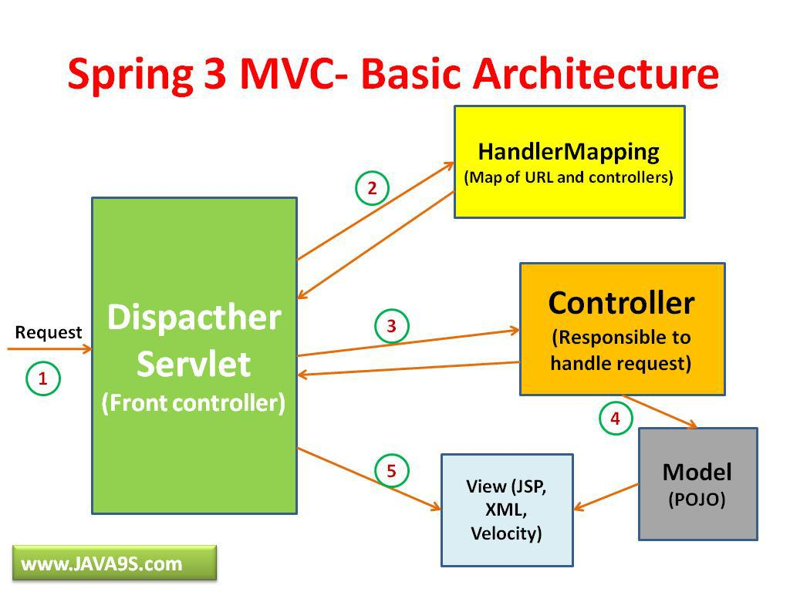
Spring Architecture
Model - encapsulates the application data and in general they will consist of POJO.
View - responsible for rendering the model data and in general it generates HTML output that the client's browser can interpret.
Controller - responsible for processing user requests and building appropriate model and passes it to the view for rendering.

Slide 11
Bean Factory
Dependency Injection
-Getters and setters Injection.
-Constructor Injection
Autowiring
It is possible to automatically let spring resolve collaborators (other beans) for your bean by inspecting the contents of the beanfactory.

Slide 12
Setter/constructor injection
Dependency injection exists in two major variants:
<Bean id="examplebean" class="examples.Examplebean">
<!-- Setter injection using the nested <ref/> element -->
<property name="beanone"><ref bean="anotherexamplebean"/></property>
<!-- Setter injection using the neater 'ref' attribute -->
<property name="beantwo" ref="yetanotherbean"/>
<property name="integerproperty" value="1"/>
</bean>
<Bean id="anotherexamplebean" class="examples.Anotherbean"/>
<bean id="yetanotherbean" class="examples.Yetanotherbean"/>
<Bean id="examplebean" class="examples.Examplebean">
<!-- Constructor injection using the nested <ref/> element -->
<constructor-arg><ref bean="anotherexamplebean"/></constructor-arg>
<!-- constructor injection using the neater 'ref' attribute -->
<constructor-arg ref="yetanotherbean"/>
<constructor-arg type="int" value="1"/>
</bean>
<Bean id="anotherexamplebean" class="examples.Anotherbean"/>
<bean id="yetanotherbean" class="examples.Yetanotherbean"/>

Slide 13
Maven
Used to maintain the project structure especially when the project grows exponentialy.
A maven repository is a directory of packaged JAR file with pom.xml file. Maven searches for dependencies in the repositories. There are 3 types of maven repository:
Local Repository
Central Repository
Remote Repository
Maven searches for the dependencies in the following order:
Local repository then Central repository then Remote repository.
Project Object Model. The pom.xml file contains information of project and configuration information for the maven to build the project such as dependencies, build directory, source directory, test source directory, plugin, goals etc.
Maven reads the pom.xml file, then executes the goal.

Slide 14
High Charts
Charts are displayed on the GUI which uses real time data.
They are developed using high charts as they provide
efficient charting capability and enhance the application.
High charts are charting libraries by JavaScript.
Issues that are recorded in the servers are put on the dashboard with the help of highcharts.
These charts are highly compatible with all the browsers and provide multi touch support.
Highcharts require jQuery dependencies. These charts take json documents as input

Slide 15
Angular JS
AngularJS is a JavaScript framework.
It is a library written in JavaScript.
AngularJS extends HTML with ng-directives.
The ng-app directive defines an AngularJS application.
The ng-model directive binds the value of HTML controls (input, select, textarea) to application data.
The ng-bind directive binds application data to the HTML view.
Data Tables- plug-in for the Javascript library.
Pagination
instant search
multi-column ordering

Slide 16
Junit
jUnit, a unit testing framework has been helpful in test-driven development.
jUnits has annotations that facilitate invocation of test methods.
Test cases are put into a test suite and they are tested sequentially.
A formal written unit test case is characterized by a known input and an expected output,
which is worked out before the test is executed.
The known input should test a precondition and the expected output should test a post-condition.

Slide 17
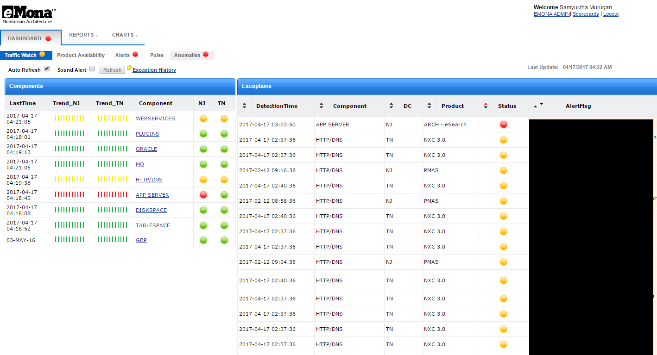
Output Snapshots
Welcome page

Slide 18
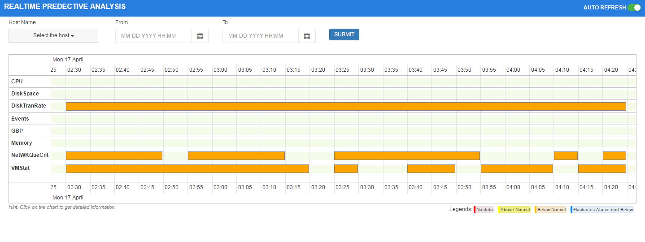
Predictive Analysis

Slide 19
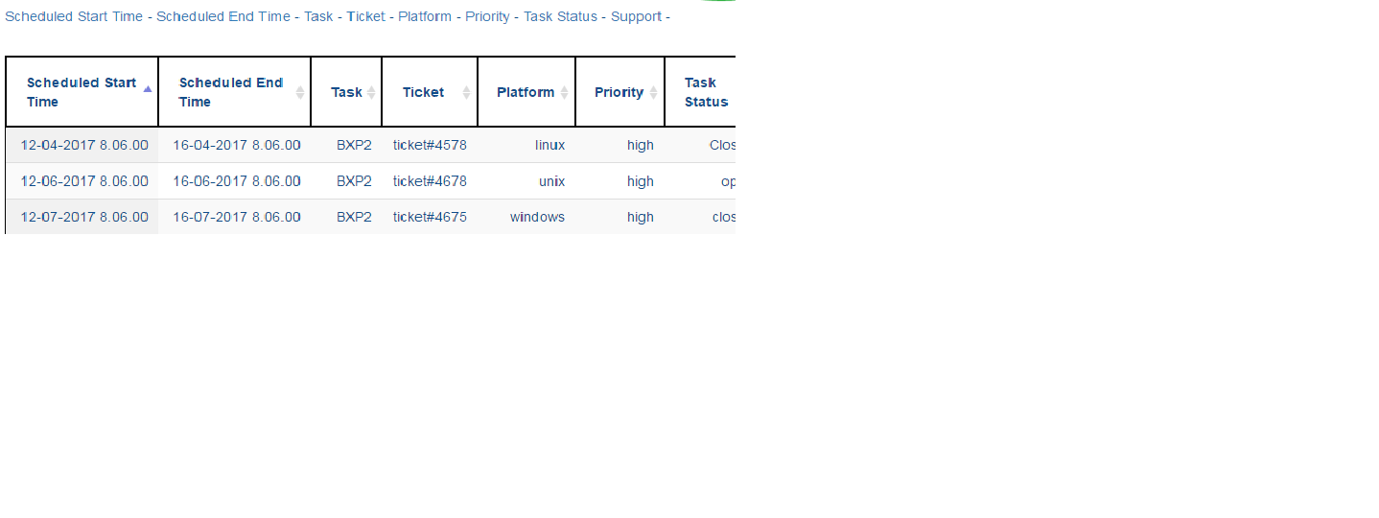
Data Table

Slide 20
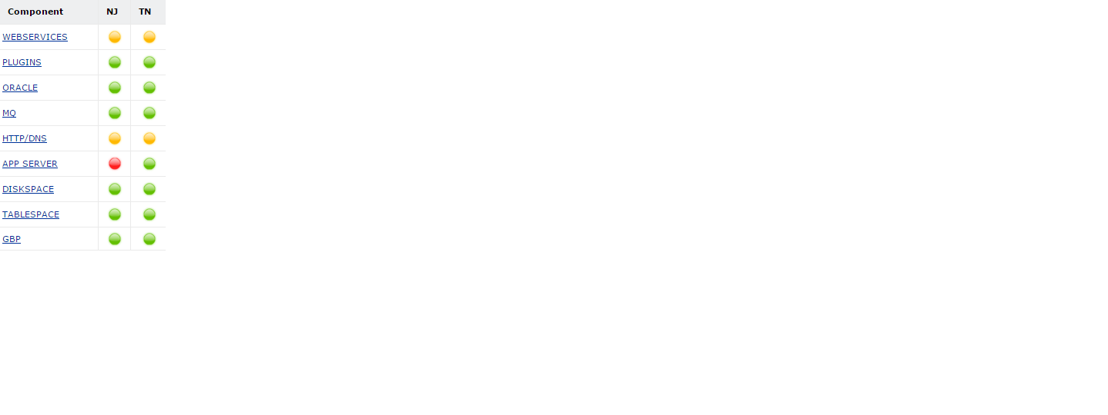
Severity of the Issues Displayed

Slide 21
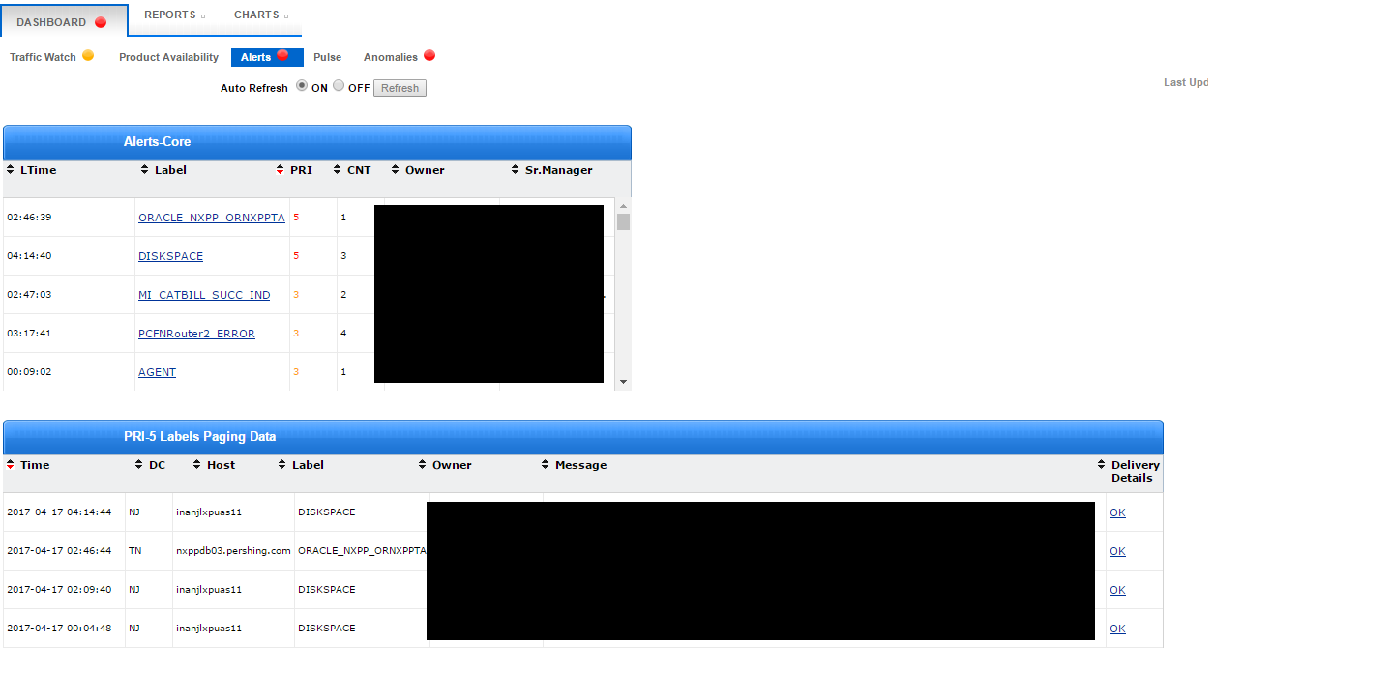
Exception History

Slide 22
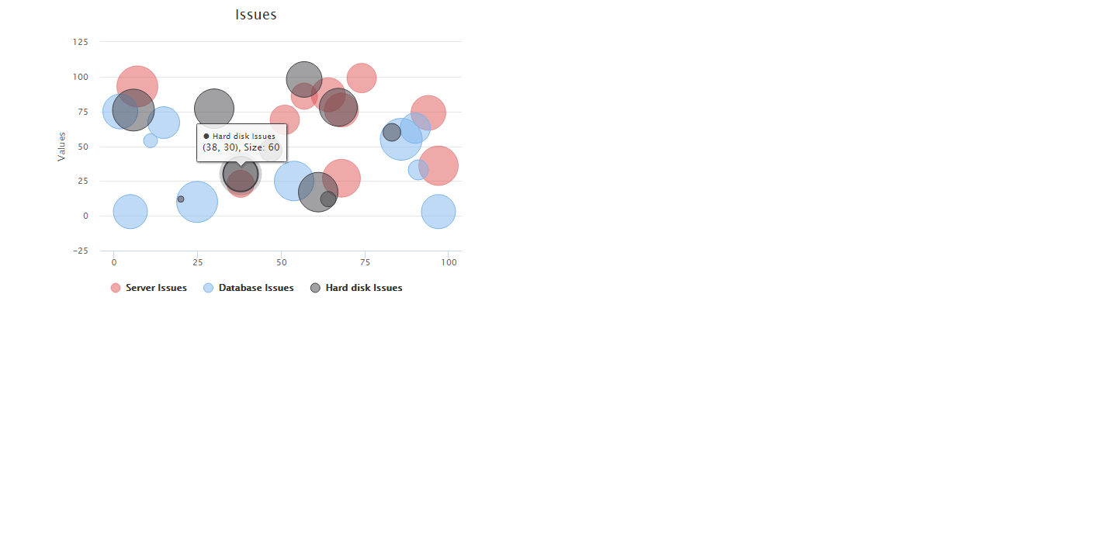
Visualisation

Slide 23
Conclusion
a monitoring architecture that would promptly report the status of any issue that has been raised
Every issue is displayed along with their priority on the dashboard.
Issues are categorized according to their domains.
It is easy for the administrator to visualize the issues through a scatter / bubble chart.
Future scope
Security Implementations can be included.
Prediction and other data mining measures can be adopted.

Slide 24
References
For spring
For Angular JS
For JUnit
For HighCharts
For Datatables

